Slide 1
Task1

Slide 2
Describtion ofPIC16F877A
The PIC microcontroller PIC16f877a is one of the most renowned microcontrollers in the industry.
This microcontroller is very convenient to use, the coding or programming of this controller is also easier. One of the main advantages is that it can be write-erase as many times as possible because it uses FLASH memory technology.
It has a total number of 40 pins and there are 33 pins for input and output.
PIC16F877A is used in many pic microcontroller projects.
PIC16F877A also have much application in digital electronics circuits.
PIC16f877a finds its applications in a huge number of devices.
It is used in remote sensors, security and safety devices, home automation and many industrial instruments.
An EEPROM is also featured in it which makes it possible to store some of the information permanently like transmitter codes and receiver frequencies and some other related data.

Slide 3
Describtion ofPIC16F877A
The cost of this controller is low and its handling is also easy.
It is flexible and can be used in areas where microcontrollers have never been used before as in microprocessor applications and timer functions etc.
It has a smaller 35 instructions set.
It can operate up to 20MHz frequency.
The operating voltage is between 4.2 volts to 5.5 volts. If you provide it voltage more than 5.5 volts, it may get damaged permanently.
It does not have an internal oscillator like other PIC18F46K22, PIC18F4550.
The maximum current each PORT can sink or source is around 100mA. Therefore, the current limit for each GPIO pin of PIC16F877A is 10 mili ampere.
It is available in four IC packaging such as 40-pin PDIP 44-pin PLCC, 44-pin TQFP, 44-pin QFN
As it has been mentioned before, there are 40 pins of this microcontroller IC. It consists of two 8 bit and one 16 bit timer.
Capture and compare modules, serial ports, parallel ports and five input/output ports are also present in it.
The picture in next slide shows the pinout diagram of PIC16F877A.

Slide 4
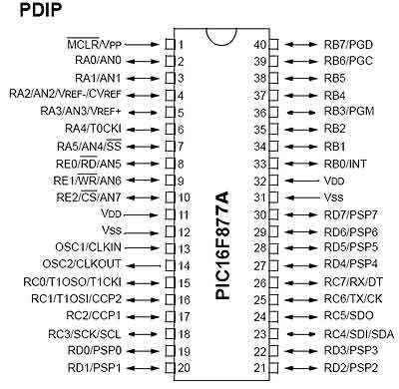
Describtion ofPIC16F877A

Slide 5
PIN 1( MCLR):
The first pin is the master clear pin of this IC. It resets the microcontroller and is active low, meaning that it should constantly be given a voltage of 5V and if 0 V are given then the controller is reset. Resetting the controller will bring it back to the first line of the program that has been burned into the IC.
A push button and a resistor is connected to the pin. The pin is already being supplied by constant 5V. When we want to reset the IC we just have to push the button which will bring the MCLR pin to 0 potential thereby resetting the controller.
PIN 2: RA0/AN0:PORTA consists of 6 pins, from pin 2 to pin 7, all of these are bidirectional input/output pins. Pin 2 is the first pin of this port. This pin can also be used as an analog pin AN0. It is built in analog to digital converter.
PIN 3: RA1/AN1:This can be the analog input 1.
PIN 4: RA2/AN2/Vref- :It can also act as the analog input2. Or negative analog reference voltage can be given to it.
PIN 5: RA3/AN3/Vref+:It can act as the analog input 3. Or can act as the analog positive reference voltage.
PIN 6: RA4/T0CKI:To timer0 this pin can act as the clock input pin, the type of output is open drain.
PIN 7: RA5/SS/AN4:This can be the analog input 4. There is synchronous serial port in the controller also and this pin can be used as the slave select for that port.
PIN 8: RE0/RD/AN5: PORTE starts from pin 8 to pin 10 and this is also a bidirectional input output port. It can be the analog input 5 or for parallel slave port it can act as a ‘read control’ pin which will be active low.
PIN 9: RE1/WR/AN6: It can be the analog input 6. And for the parallel slave port it can act as the ‘write control’ which will be active low.
PIN 10: RE2/CS/A7: It can be the analog input 7, or for the parallel slave port it can act as the ‘control select’ which will also be active low just like read and write control pins.
PIN 11 and 32: VDD: These two pins are the positive supply for the input/output and logic pins. Both of them should be connected to 5V.
PIN 12 and 31: VSS: These pins are the ground reference for input/output and logic pins. They should be connected to 0 potential.
PIN 13: OSC1/CLKIN: This is the oscillator input or the external clock input pin.
PIN 14: OSC2/CLKOUT: This is the oscillator output pin. A crystal resonator is connected between pin 13 and 14 to provide external clock to the microcontroller. ¼ of the frequency of OSC1 is outputted by OSC2 in case of RC mode. This indicates the instruction cycle rate.

Slide 6
PIN 15: RC0/T1OCO/T1CKI: PORTC consists of 8 pins. It is also a bidirectional input output port. Of them, pin 15 is the first. It can be the clock input of timer 1 or the oscillator output of timer 2.
PIN 16: RC1/T1OSI/CCP2: It can be the oscillator input of timer 1 or the capture 2 input/compare 2 output/ PWM 2 output.
PIN 17: RC2/CCP1: It can be the capture 1 input/ compare 1 output/ PWM 1 output.
PIN 18: RC3/SCK/SCL: It can be the output for SPI or I2C modes and can be the input/output for synchronous serial clock.
PIN 23: RC4/SDI/SDA: It can be the SPI data in pin. Or in I2C mode it can be data input/output pin.
PIN 24: RC5/SDO: It can be the data out of SPI in the SPI mode.
PIN 25: RC6/TX/CK: It can be the synchronous clock or USART Asynchronous transmit pin.
PIN 26: RC7/RX/DT: It can be the synchronous data pin or the USART receive pin.
PIN 19,20,21,22,27,28,29,30: All of these pins belong to PORTD which is again a bidirectional input and output port. When the microprocessor bus is to be interfaced, it can act as the parallel slave port.
PIN 33-40: PORT B: All these pins belong to PORTB. Out of which RB0 can be used as the external interrupt pin and RB6 and RB7 can be used as in-circuit debugger pins.
Note: All pins have multiple functionalities. Like PORTC pins can be used as digital input pins, digital output pins, for UART communication, I2C communication. But, we can use one function of each port at a time or you have to program it smartly so that you can switch between different functionalities. Like once you need one pin to read analog signal, define it for analog purpose and then switch to other functions like digital output etc. For beginners, we suggest to use one pin for single functionality and you can use multi-function mode, once you become an expert in programming.

Slide 7
b)explain the functions of main blocks in PIC16F877A
the function of ALU in PIC microcontroller:
To operate on data memory, the Arithmetic Logical Unit (ALU) is required. In addi- tion to performing arithmetical and logical operations, the ALU controls status bits (which are found in the STATUS register). The result of some instructions force status bits to a value depend- ing on the state of the result.
Program Counter (PC) keeps track of the program execution by holding the address of the current instruction. It is automatically incremented to the next instruction during the current instruction execution.
the function of STATUS register in PIC microcontroller:
The STATUS register is of most importance to programming the PIC, it contains the arithmetic status of the ALU (Arithmetic Logic Unit), the RESET status and the bank select bit for data memory. As with any register, the STATUS register can be the destination for any instruction.
the function of Control and Status Register in PIC microcontroller:
Control and Status Register (CSR) is a register in many central processing units and many microcontrollers that are used to store information about instructions received from machines.

Slide 8
the function of program counter in PIC microcontroller:
The PIC16F87XA family has an 8-level deep x 13-bit wide hardware stack. The stack space is not part of either program or data space and the stack pointer is not readable or writable. In the PIC microcontrollers, this is a special block of RAM memory used only for this purpose.
The CALL instruction is used to jump to a subroutine, which must be terminated with the RETURN instruction. CALL has the address of the first instruction in the subroutine as its operand. When the CALL instruction is executed, the destination address is copied to the PC. The PC is PUSHed onto the stack when a CALL instruction is executed, or an interrupt causes a branch. The stack is POP’ed in the event of a RETURN, RETLW or a RETFIE instruction execution.
The stack operates as a circular buffer. This means that after the stack has been PUSHed eight times, the ninth push overwrites the value that was stored from the first push. The tenth push overwrites the second push (and so on).
Each time the main program execution starts at address 0000 - Reset Vector. The address 0004 is “reserved” for the “interrupt service routine” (ISR).
If we plan to use an interrupt, our program will begin after the Interrupt Vector; and if not we can start to write from the beginning of the Reset Vector.

Slide 9
the function of Flash Program Memory in PIC microcontroller:
This memory is used to store the program after we burn it to the microcontroller. The PIC16F876A/877A devices have 8K words x 14 bits of Flash program memory that can be electrically erased and reprogrammed. Each time we burn program into the micro, we erase an old program and write a new one.
the function of instruction register in PIC microcontroller:
In computing, the instruction register (IR) or current instruction register (CIR) is the part of a CPU's control unit that holds the instruction currently being executed or decoded.
the function of instruction decoder in PIC microcontroller:
The instruction decoder decodes the IR value to the set of control signals. The signal decides which operation should be operated, the location of the source operands in the RF, and where the destination operand is located to store its operation result.

Slide 10
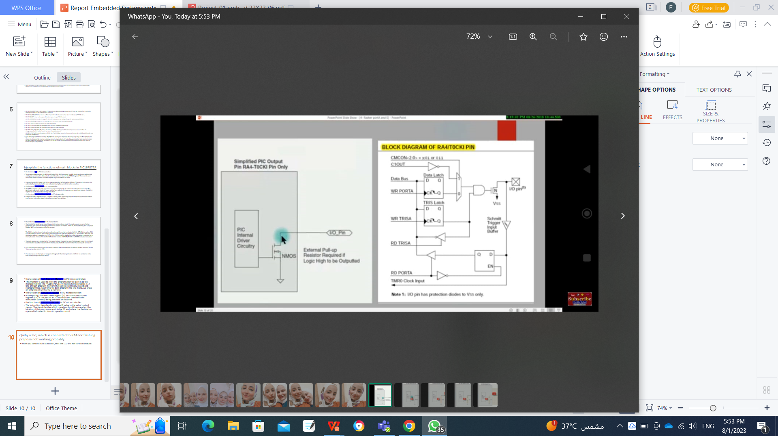
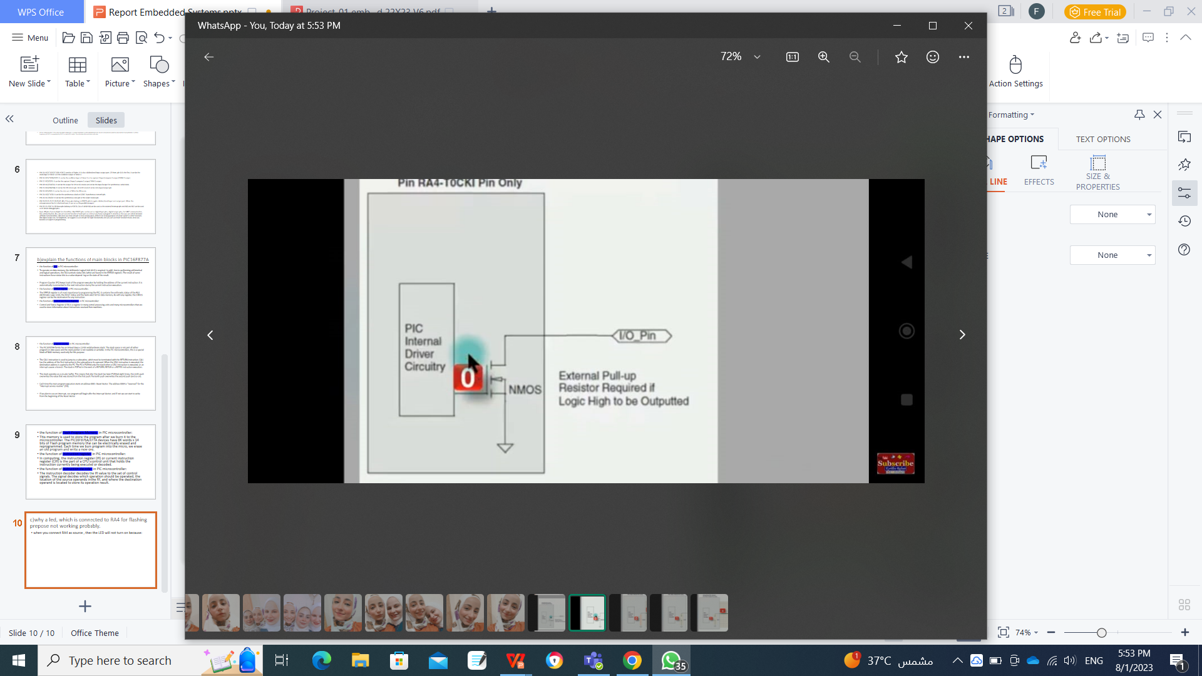
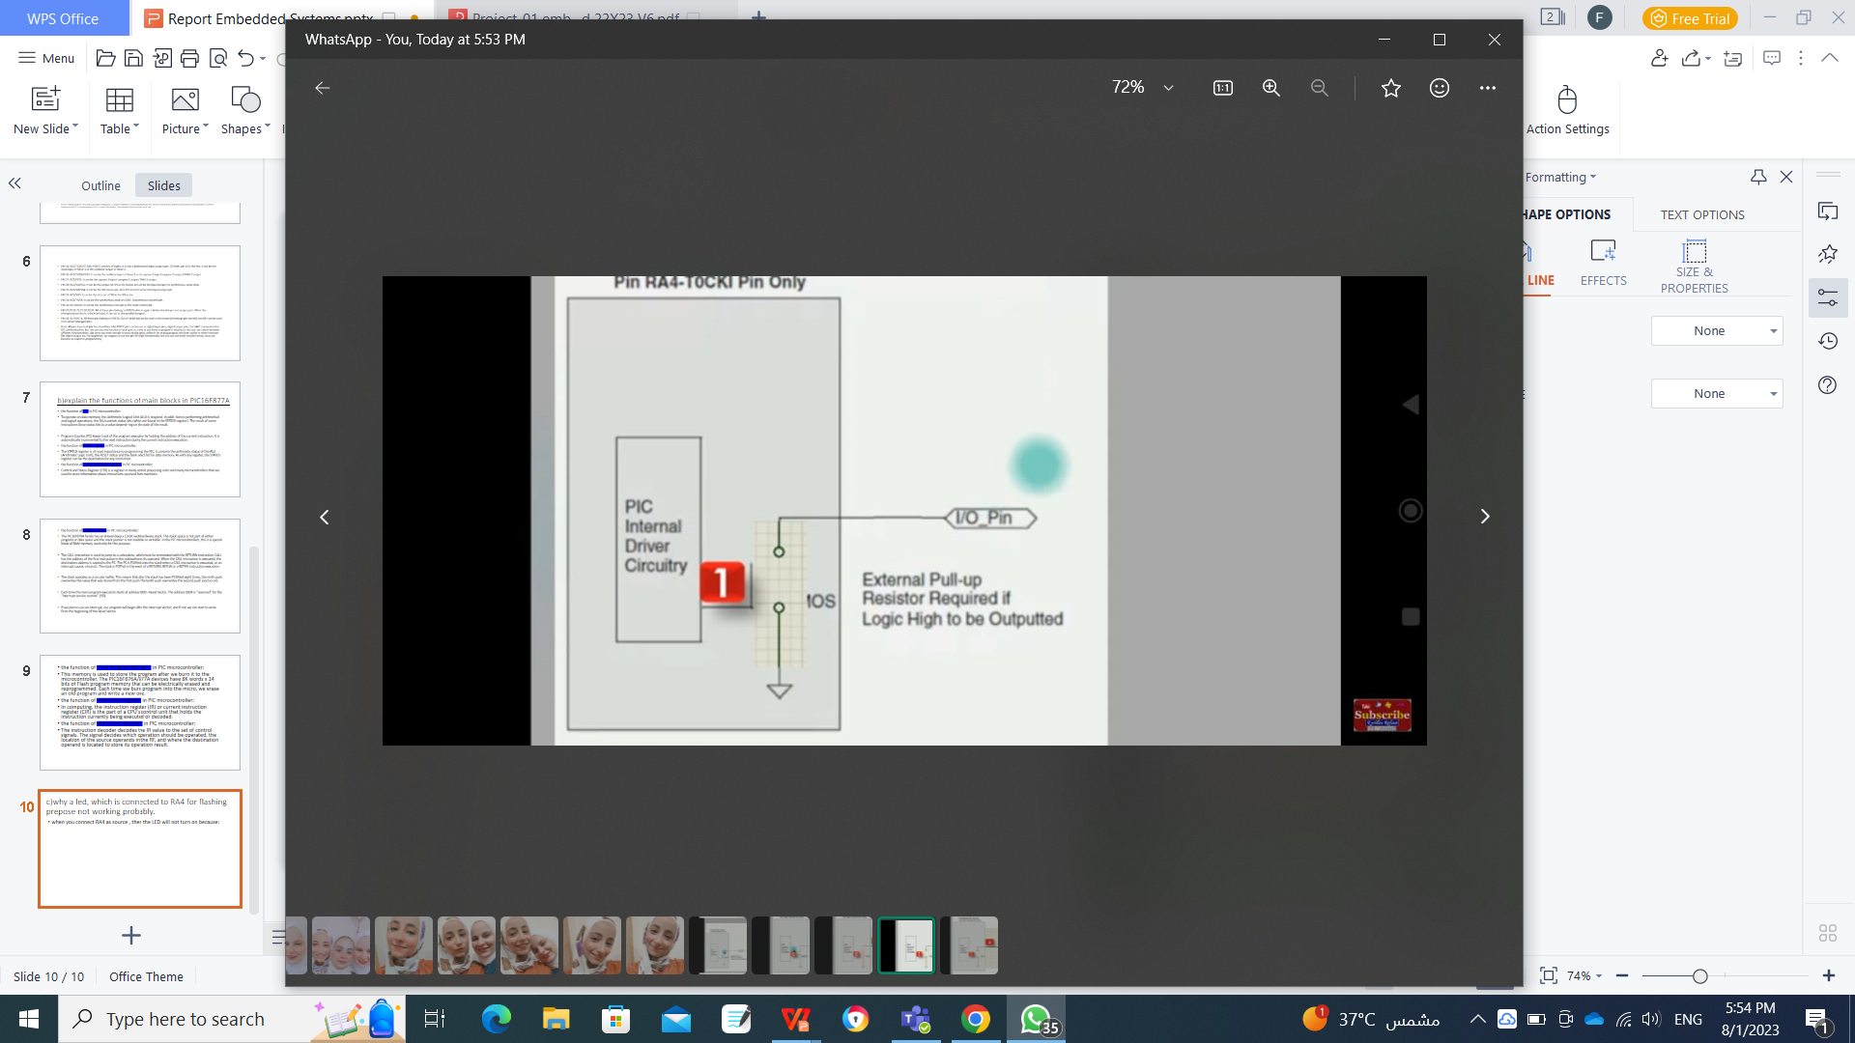
c)why a led, which is connected to RA4 for flashing prepose not working probably.
when you connect RA4 as source , then the LED will not turn on because:

Slide 11
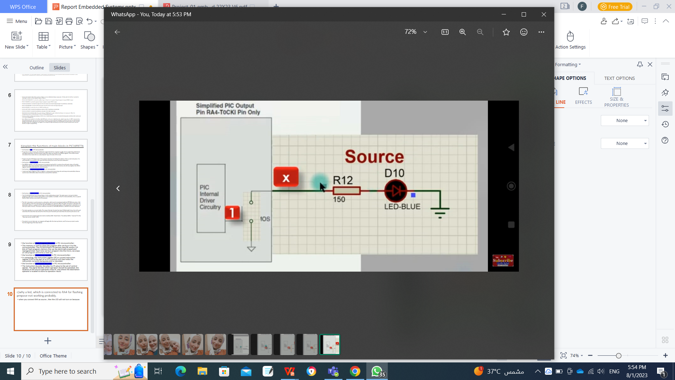
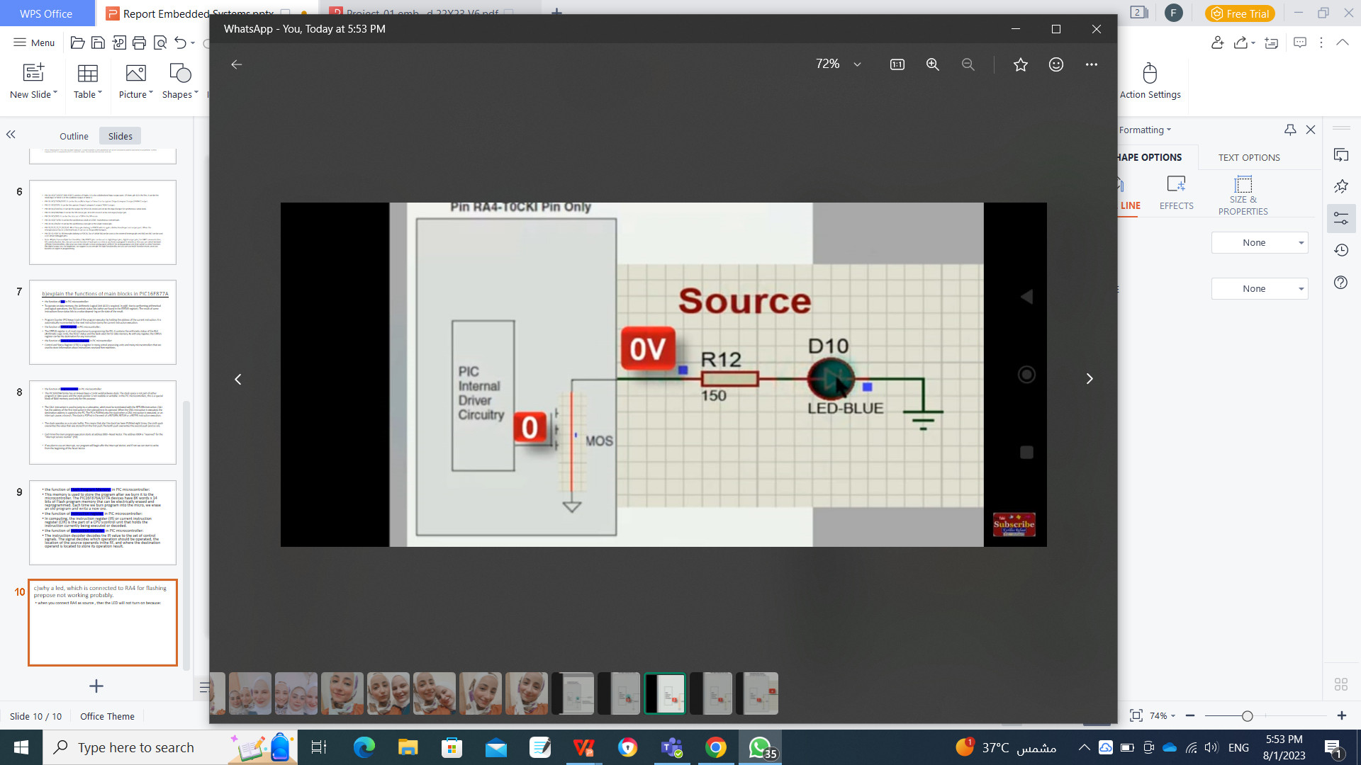
so you must conect it to Zero volt as(sunk)

Slide 12
comparing the memory size, the power consumption, pin count for ATMEGA23 and PIC16F877A
 | ATMEGA23 | PIC16F877A
Program Memory Size (KB) | 32kB | 8K×14 bit
power consumption | 26uA at 5V and 21uA at 3.3V. | 220mA (2.0V, 4MHz)
pin count | 40 | 40

Slide 13
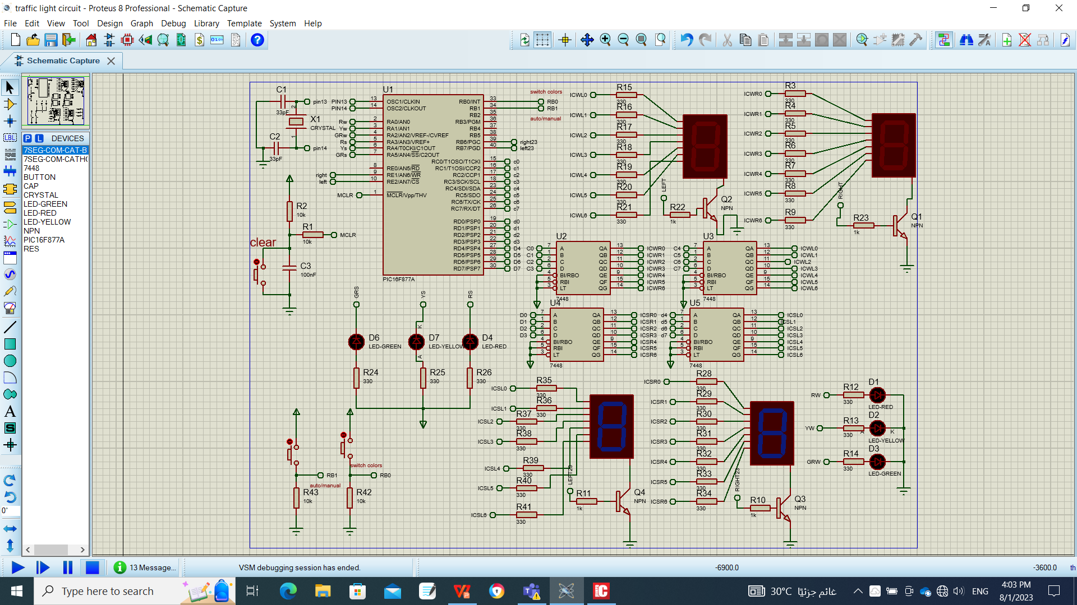
The circuit design on protoues

Slide 14
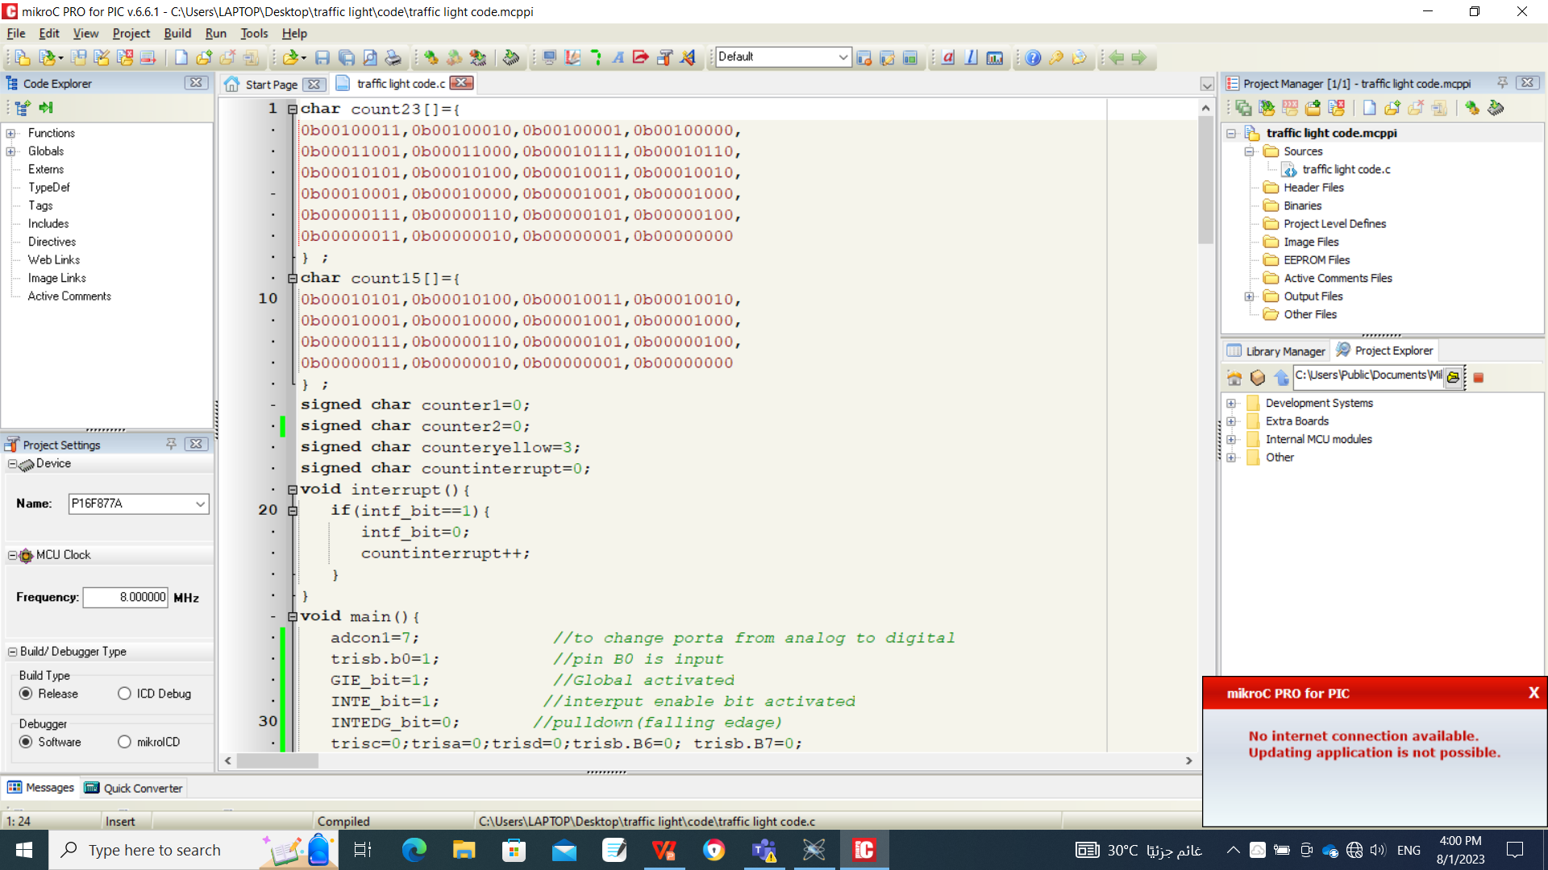
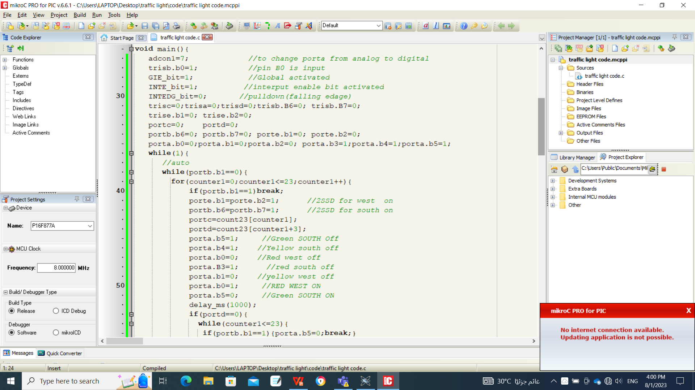
the code on mikro-c

Slide 15
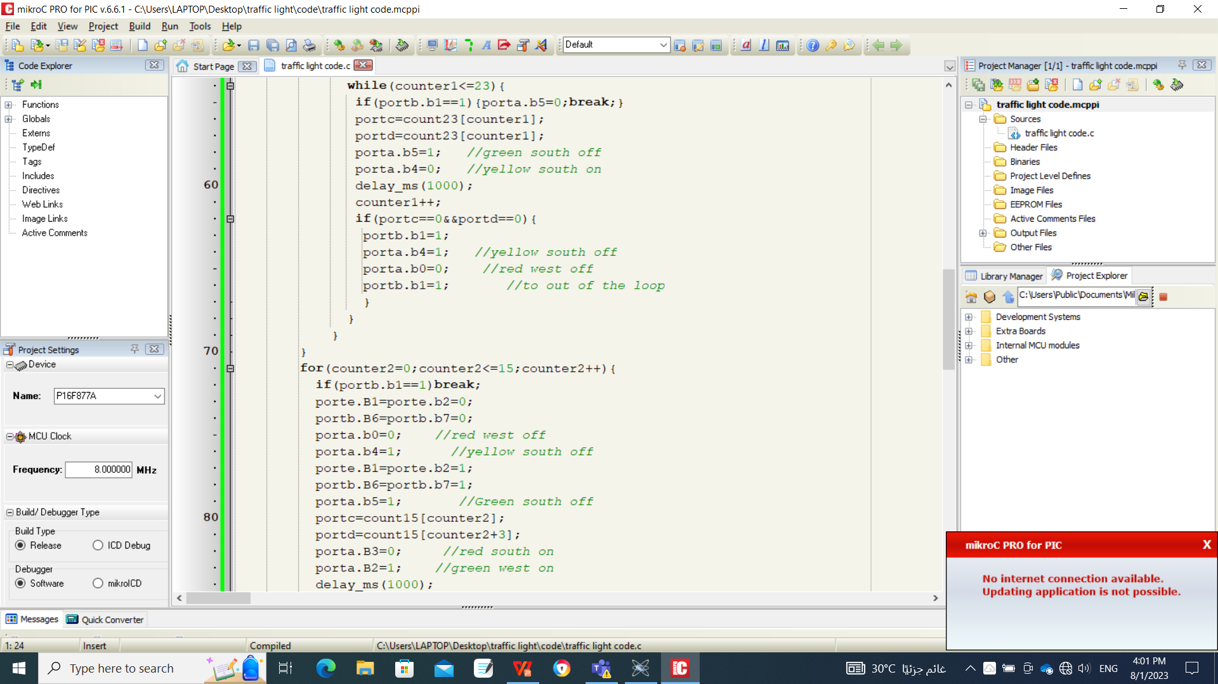
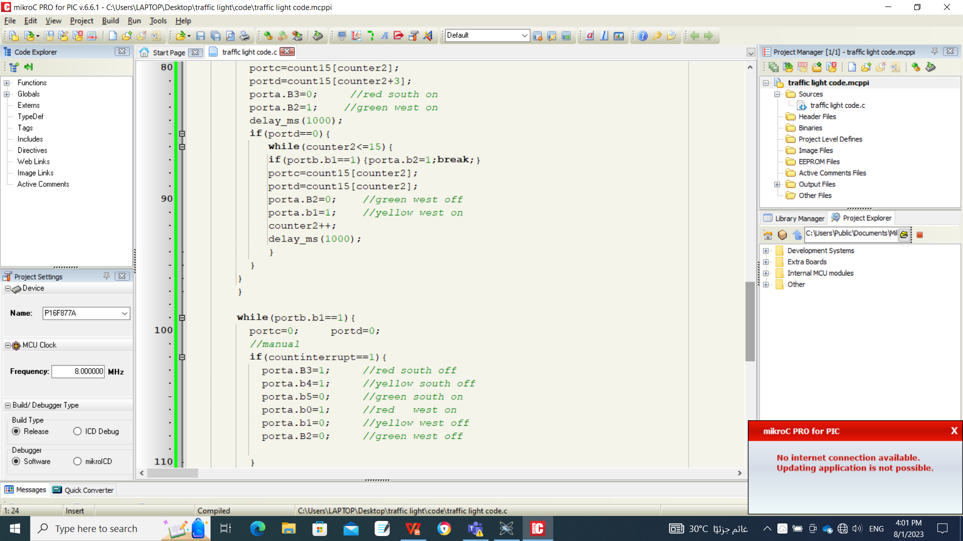
the code on mikro-c

Slide 16
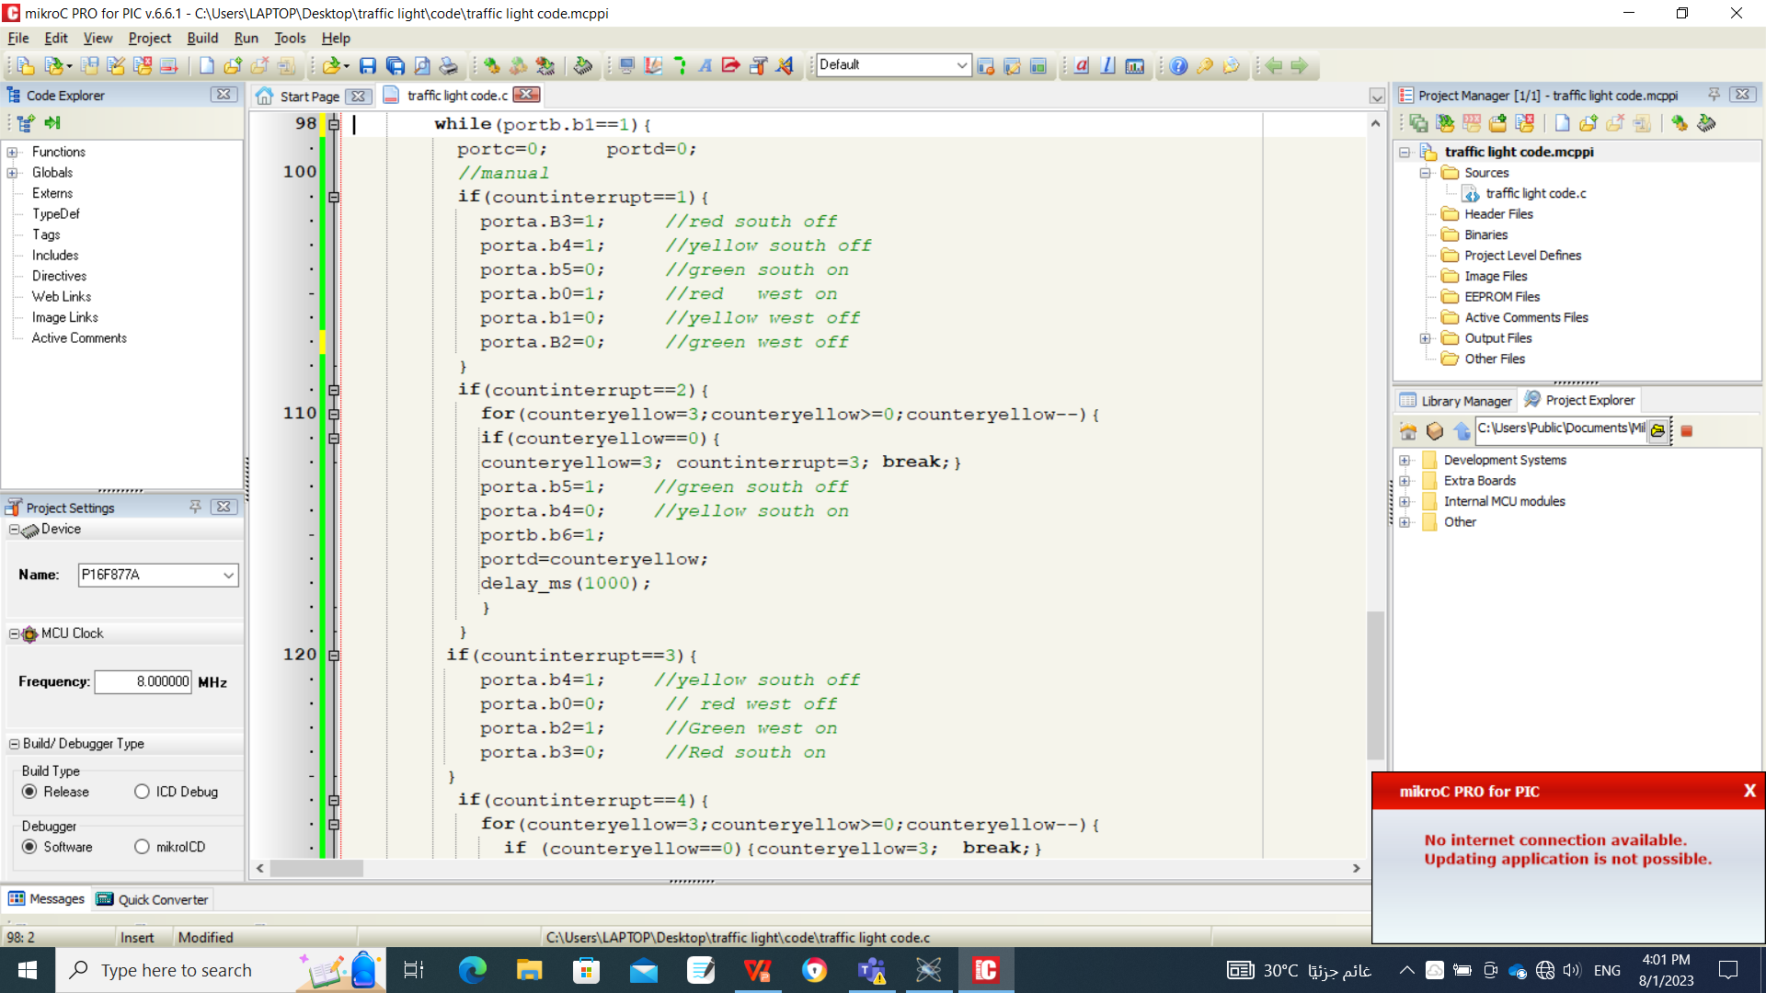

the code on mikro-c

